Slide 1
AI-Based Hand Drawn Circuit to Digital Schematic Converter Team ID: H26EDU02
College Name: K. Ramakrishnan College of Engineering
Team Leader: Guruprasath J
Team Members:
Guruprasath J
Charan Raj I
Hari Priya J

Slide 2
Problem statement
Existing tools require manual redrawing, making documentation and circuit analysis difficult. Converting hand-drawn circuit diagrams into digital schematics is a time-consuming and error-prone process.
OBJECTIVE
Detect electronic components from hand-drawn circuit images.
Detect wires and identify component connections.
Convert the detected circuit into a digital schematic automatically.
Reduce manual effort and improve accuracy.

Slide 3
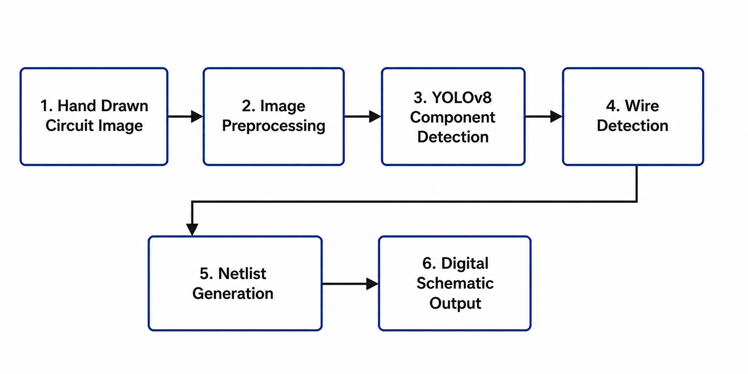
BLOCK DIAGRAM

Slide 4
ALGORITHMS
Schematic Generation
Netlist Creation
Schemdraw Rendering
Component Detection
YOLO8V
Bounding Box Detection
Confidence values
Wire Detection
Image Thresholding
Skeletonization
Wire Pixel Extraction

Slide 5
Technology stack
Programming Language
Python, HTML
AI Framework
Ultralytics YOLO8V
Computer Vision
OpenCV
Scikit-Image
Schematic Drawing
Schemdraw
User Interface
Streamlit
Dataset
Roboflow PCB Doctor Dataset

Slide 6
Results & demo

Slide 7
NOVELTY COMPARISION
Feature | Existing Solutions | Our Project
Hand-drawn circuit recognition | ❌ | ✅
AI component detection | Limited | ✅
Automatic wire detection | ❌ | ✅
Automatic graph generation | ❌ | ✅
Automatic digital schematic | Partial | ✅
Simple web interface | ❌ | ✅
AI-powered hand-drawn circuit recognition.
Automatic component and wire extraction.
Easy-to-use Streamlit interface.

Slide 8
Summary & Future Work
Summary
Developed an AI-assisted system to convert hand-drawn circuits into digital schematics.
Implemented component detection using YOLOv8.
Extracted wire information through image processing and generated a prototype digital schematic.
Future Work
Improve junction detection accuracy.
Support more electronic components.
Export to KiCad and LTspice.
Automatic circuit simulation.
Mobile application support.

Slide 9
From Prototype to Product
Improve AI Accuracy – More components & better wire detection
Automated Schematic – Convert drawings into editable circuits
Circuit Validation – Detect connection errors
Export & Simulation – KiCad / LTspice support
Web & Mobile App – Easy access anywhere

